Slide 1

Trupal Patel
Richard Zins (Advisor)

Slide 2

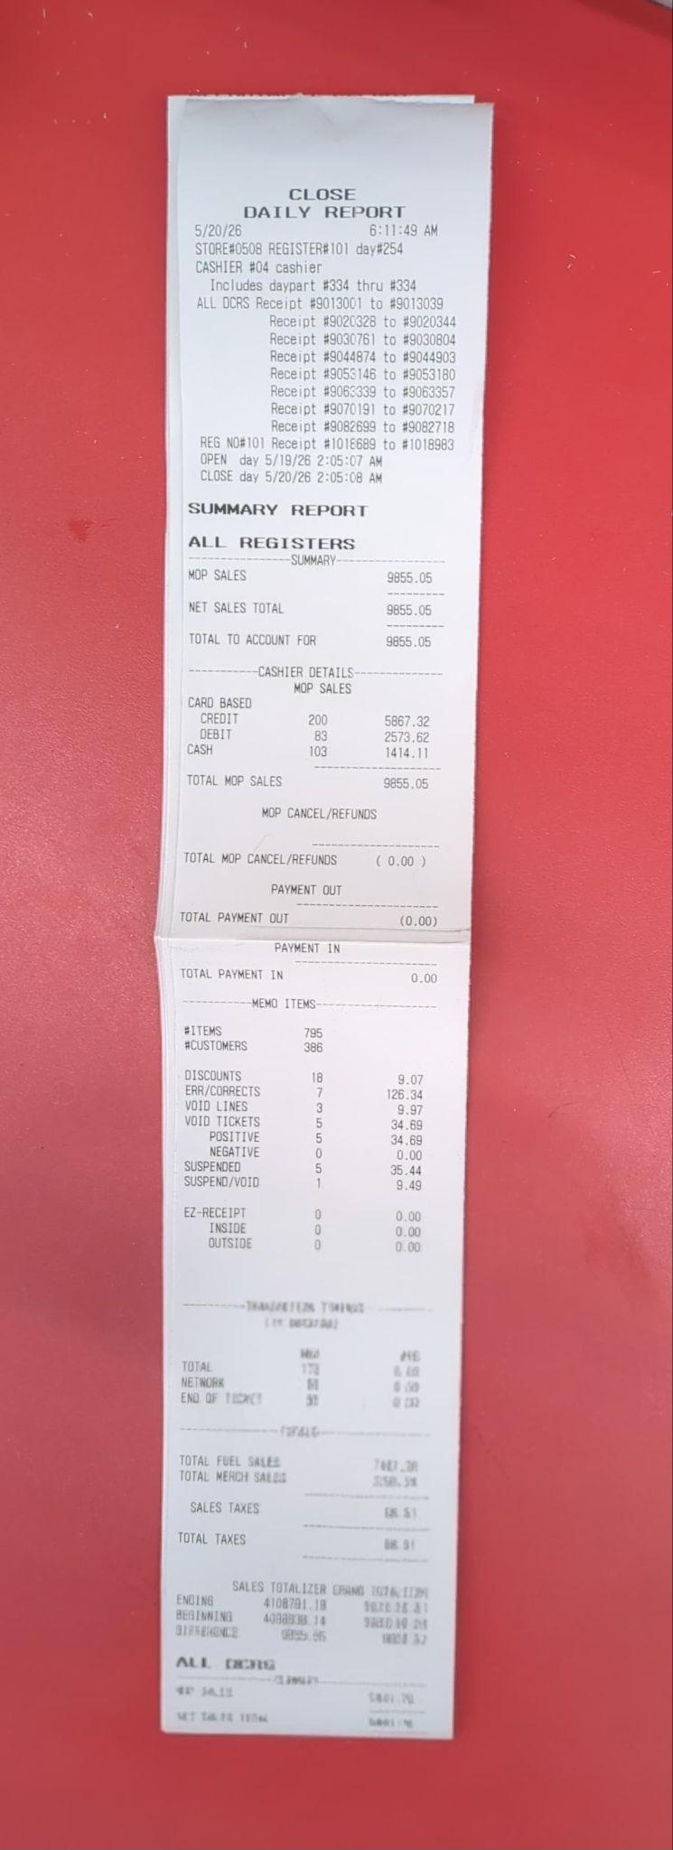
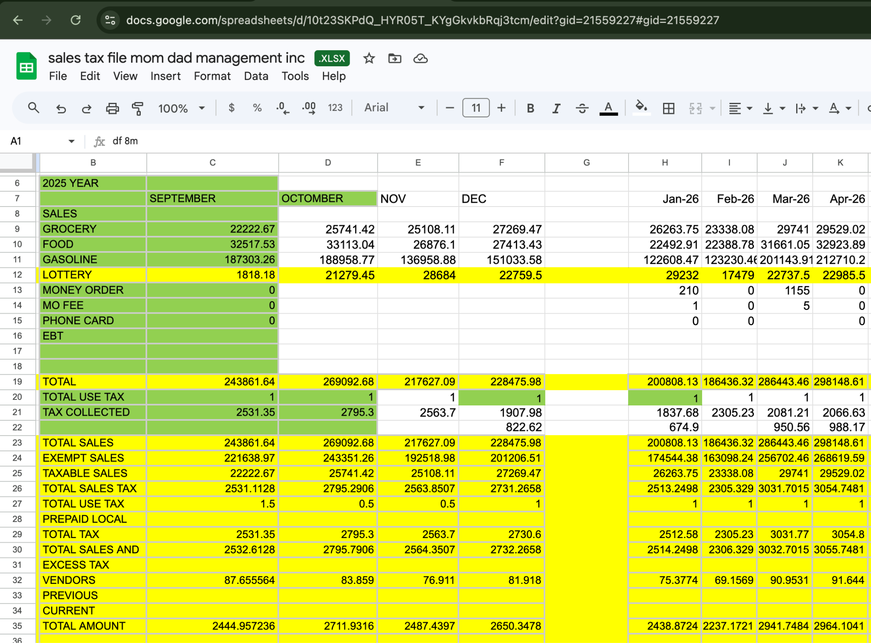
Problem Statement - POS
Retail bookkeeping often starts with printed POS slips and monthly summaries that are stored physically and reviewed manually when sales tax or daily register cash needs to be calculated.
Printed Report Sale Tax Calculation Sheet
RetailSync

Slide 3
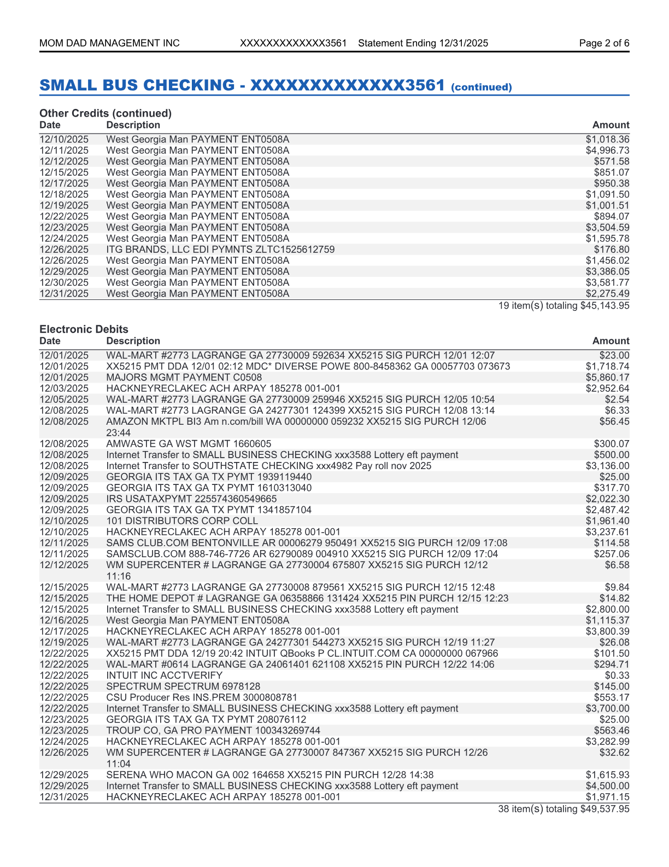
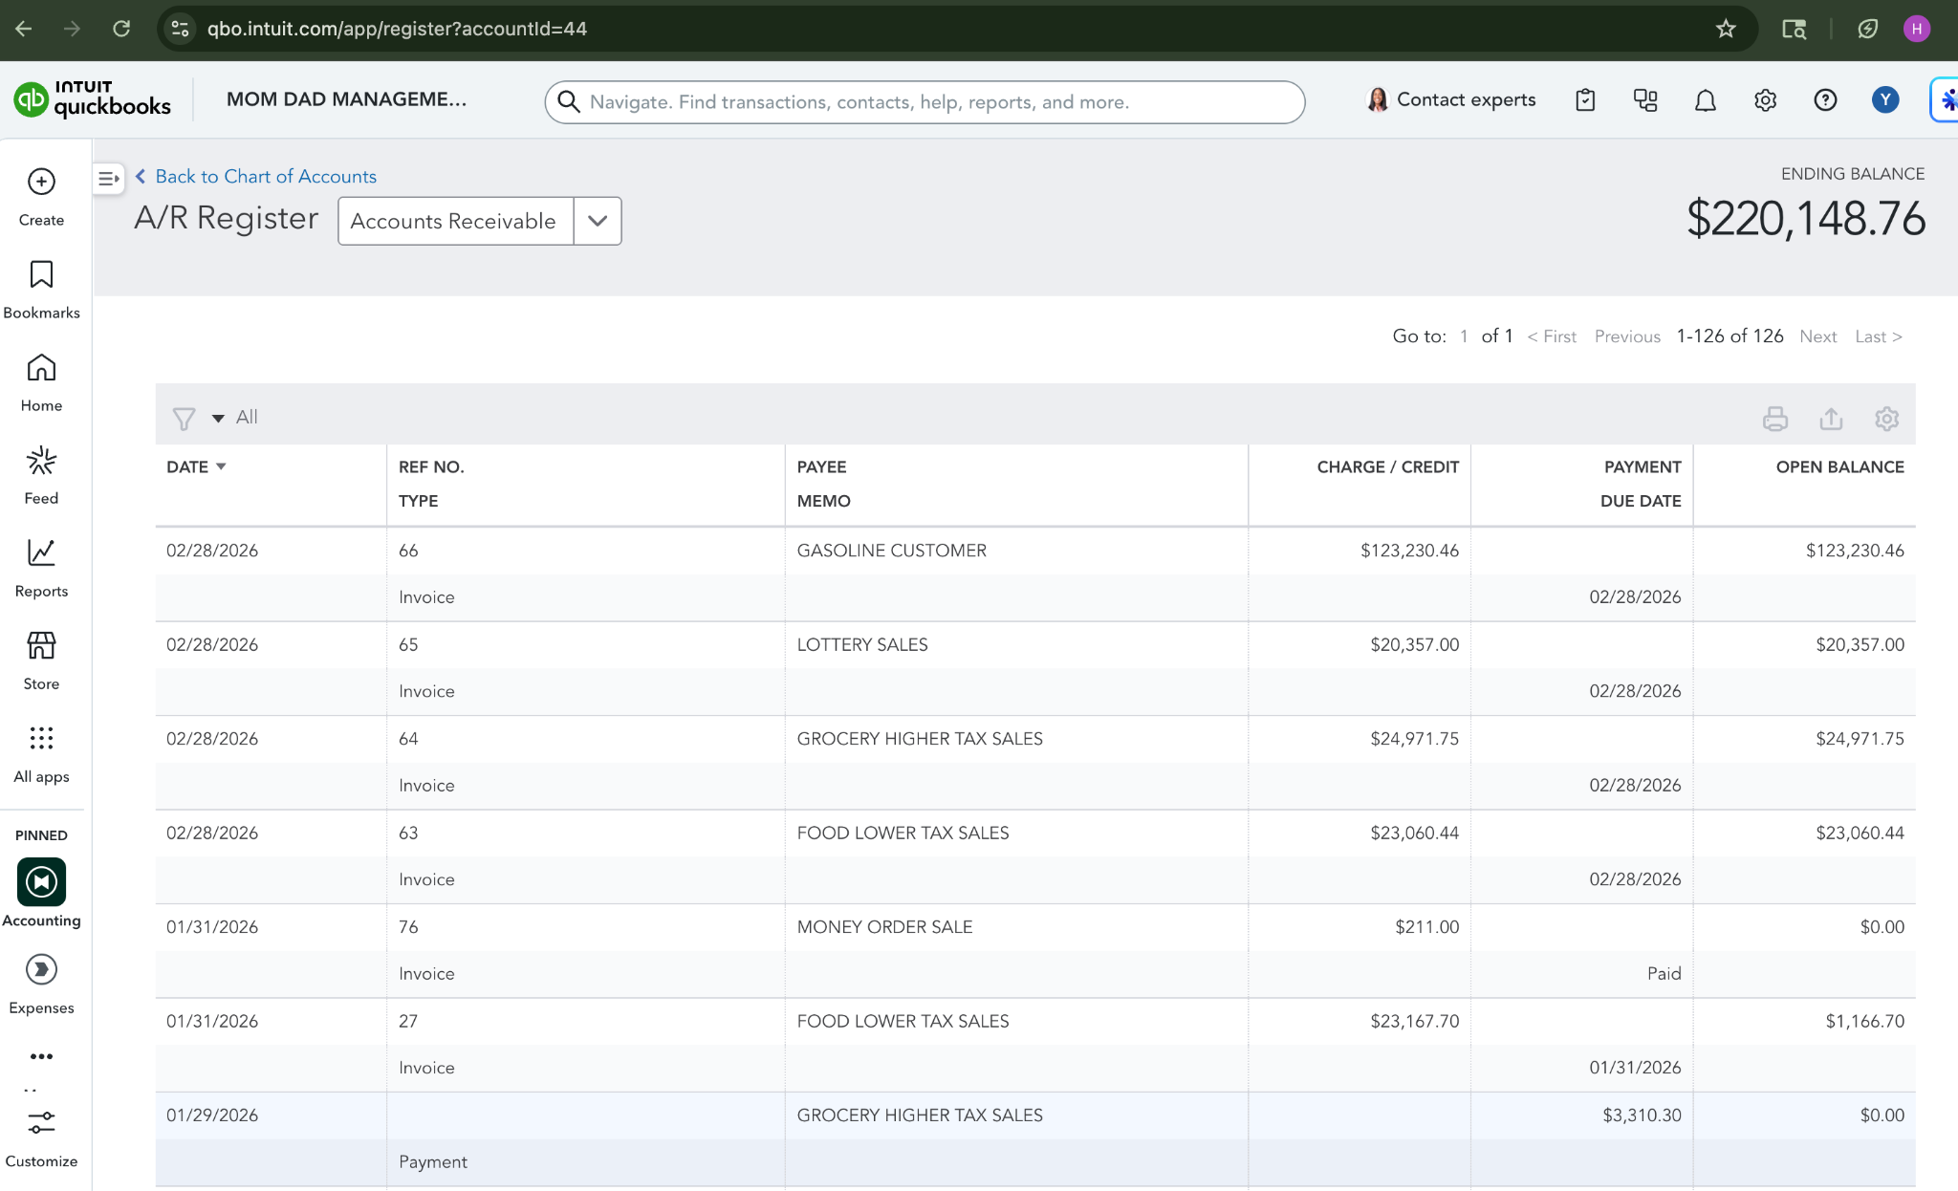
Problem Statement - Accounting
Bank statements must be reviewed line by line and manually entered into QuickBooks, requiring each transaction to be categorized, matched, and confirmed before posting.
Bank Statement Quickbooks Register
RetailSync

Slide 4
Project Goal
Build a structured retail bookkeeping workflow that helps users digitize POS records, review bank statements, and prepare accounting entries before QuickBooks posting.
Digitize POS Records
Reports
&
Sale Tax Calculations
Streamline Accounting Review
RetailSync

Slide 5
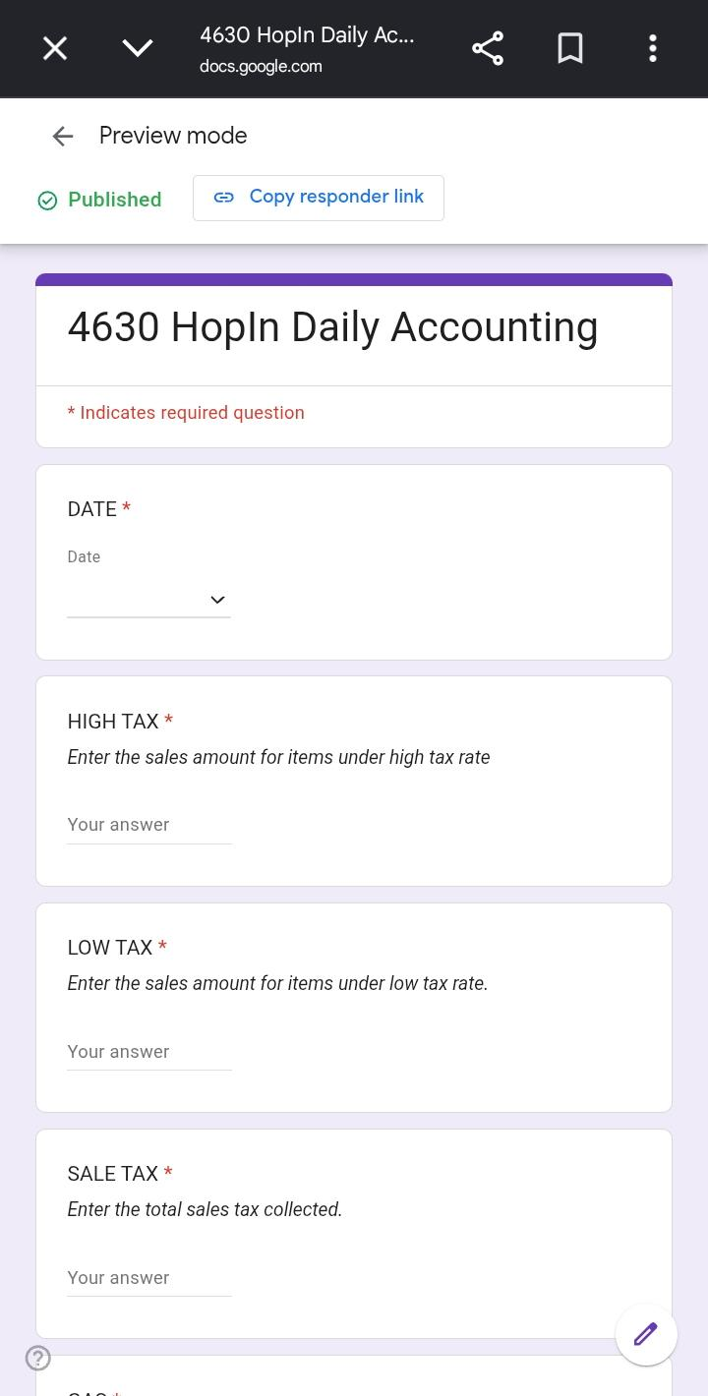
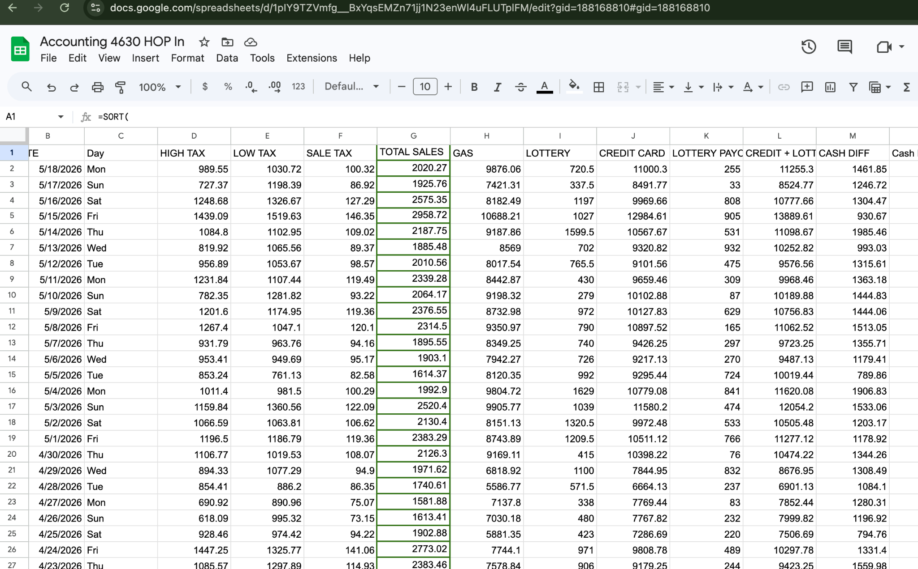
Solution Approach - POS
The POS workflow was digitized using Google Forms and Google Sheets, allowing daily report data to be captured, cleaned, calculated, and prepared for use inside RetailSync.
Daily POS Data Form Clean Data Sheet
RetailSync

Slide 6
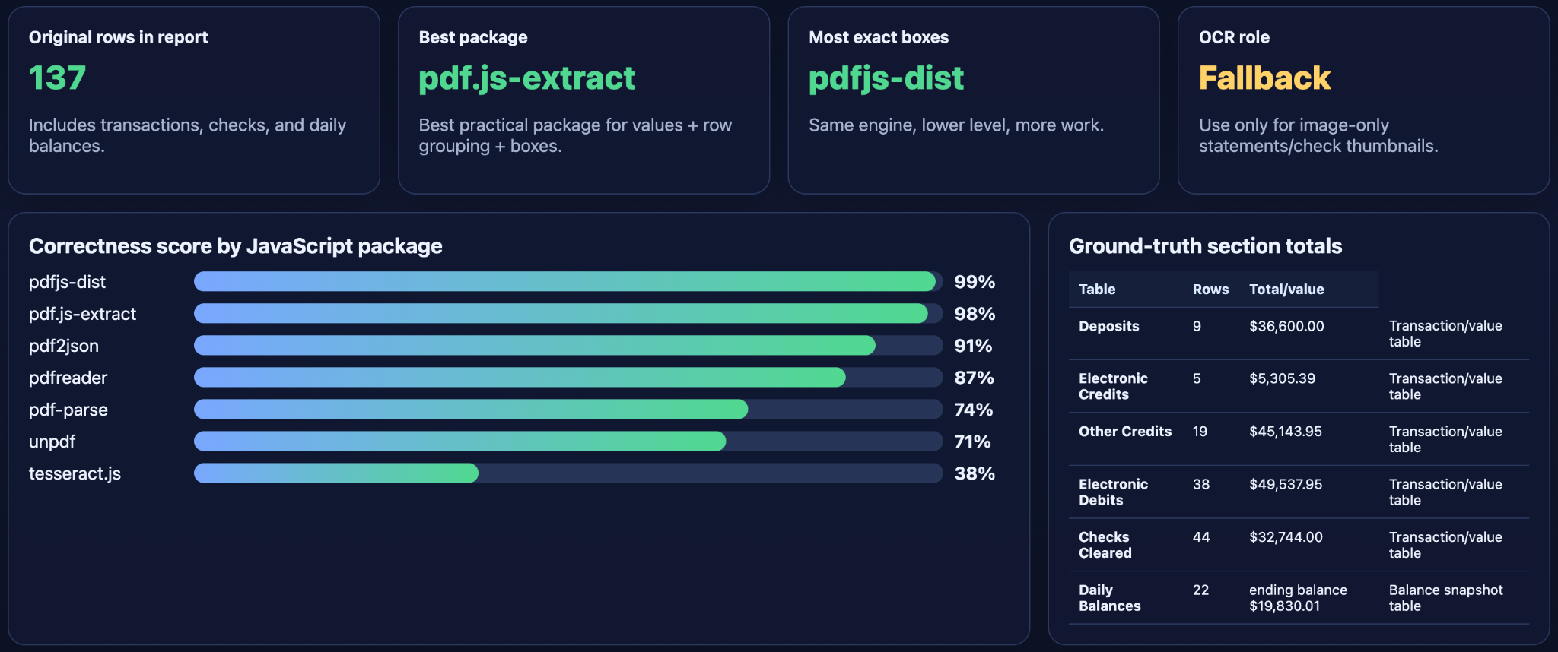
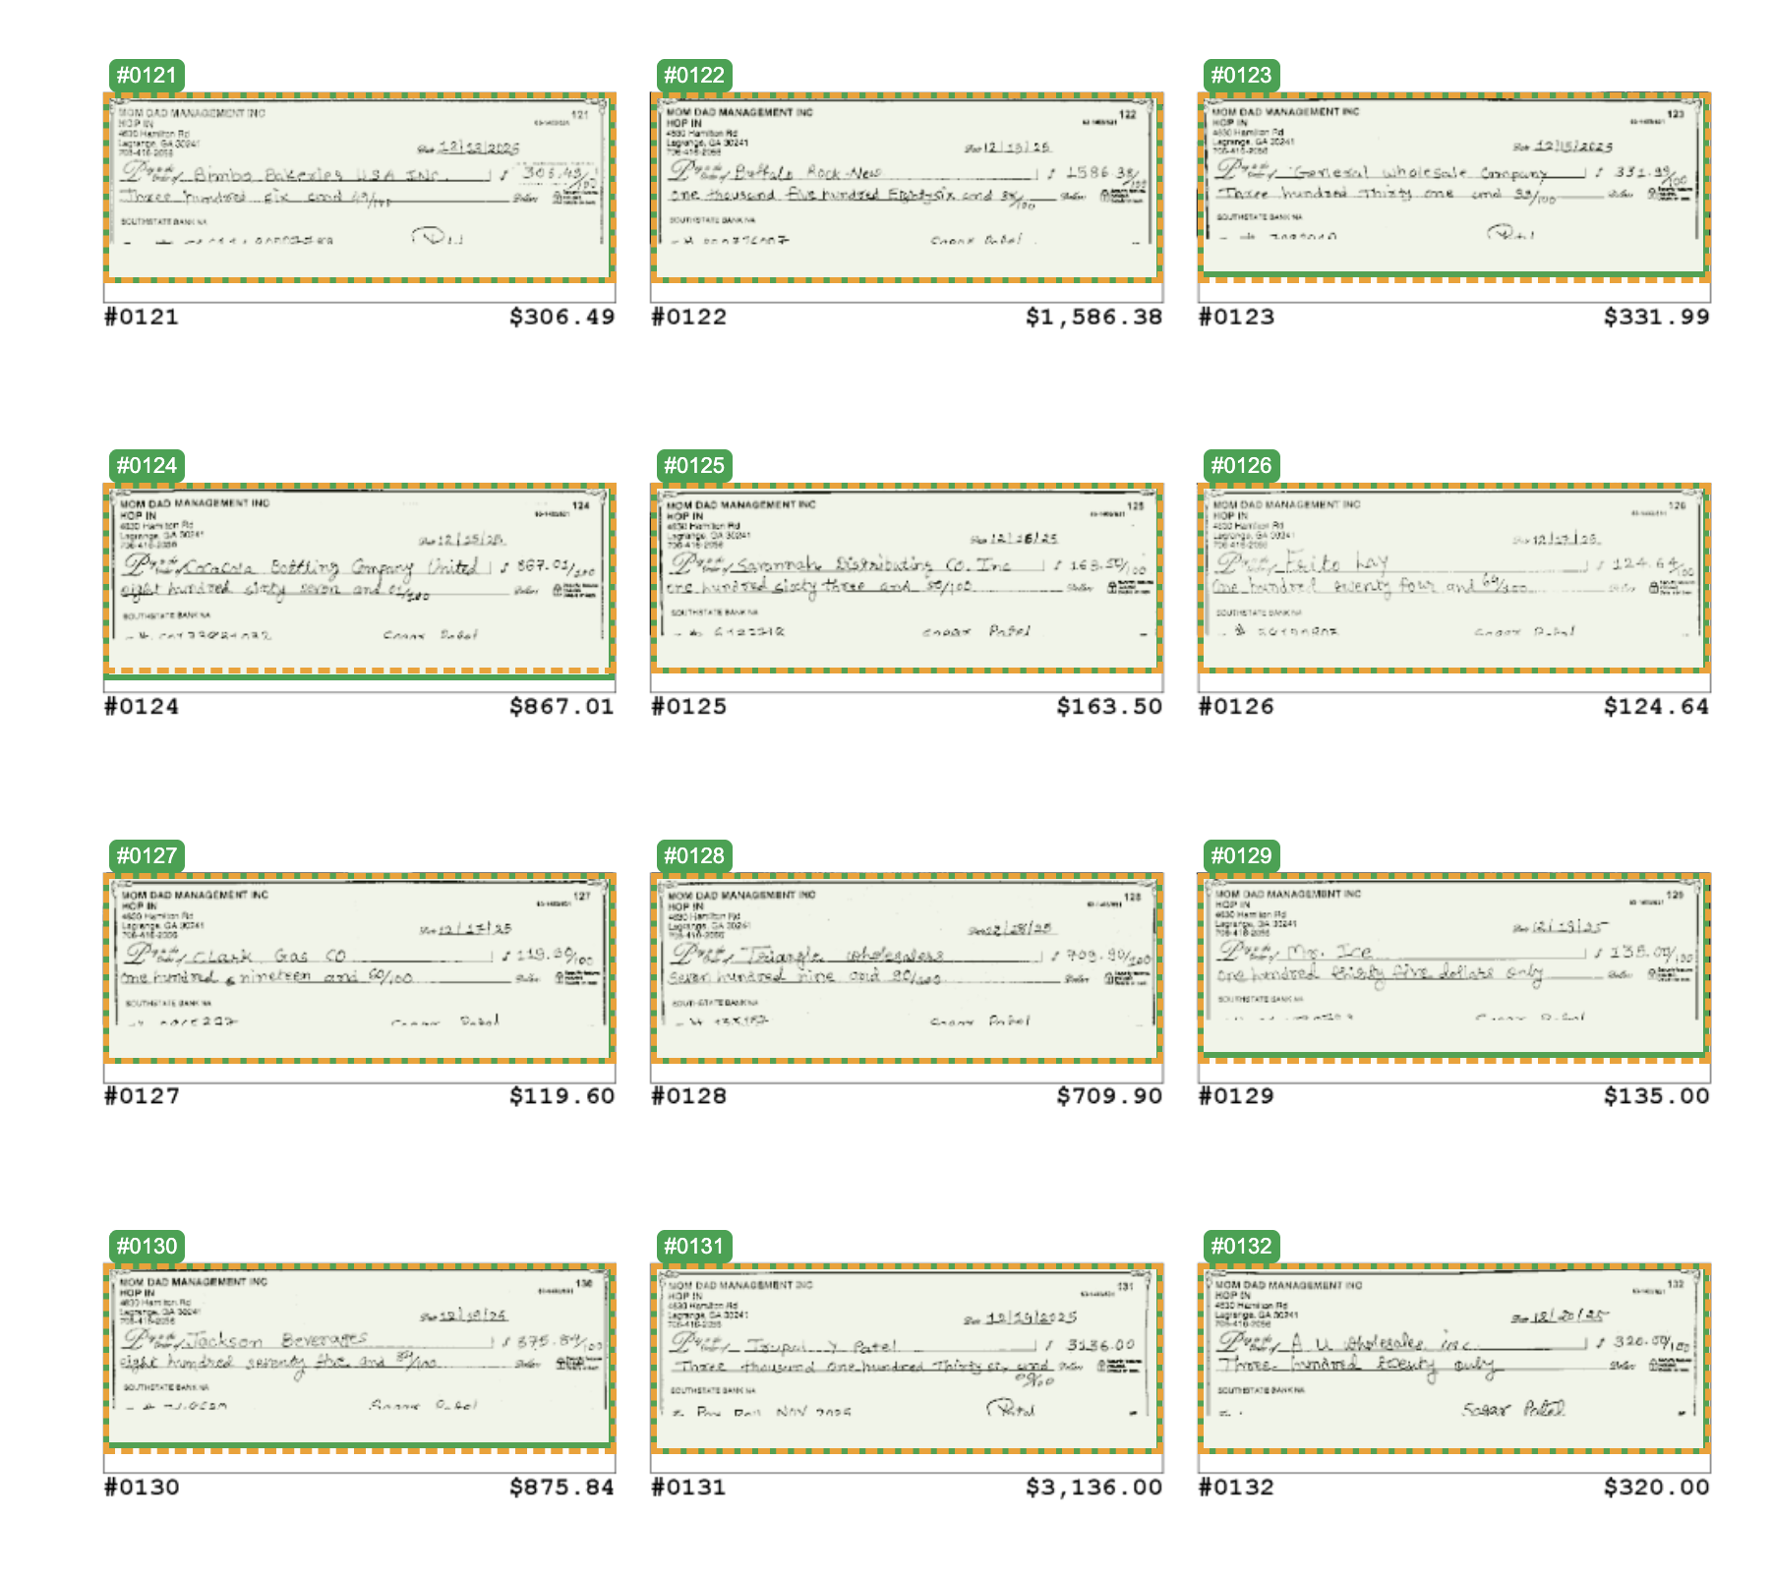
Solution Approach - Accounting
To reduce manual bank statement entry, I evaluated multiple JavaScript PDF parser packages, compared their extraction accuracy, and used bounding-box results to verify which approach worked best for RetailSync’s accounting review workflow.
JavaScript PDF Parser Package Comparison Check Detection
RetailSync

Slide 7

[Business Owner ]
We have printed POS reports, monthly summaries, bank statements, and QuickBooks entries that still need to be reviewed manually. Can you try building something to make this easier?
RetailSync is a web-based bookkeeping platform that connects POS records, sales tax calculations, bank statement processing, and QuickBooks accounting review into one structured workflow.
[Me]
I have used QuickBooks APIs before, so I can try building SOMETHING to digitize POS records, support sales tax calculations, and simplify accounting review.
RetailSync

Slide 8
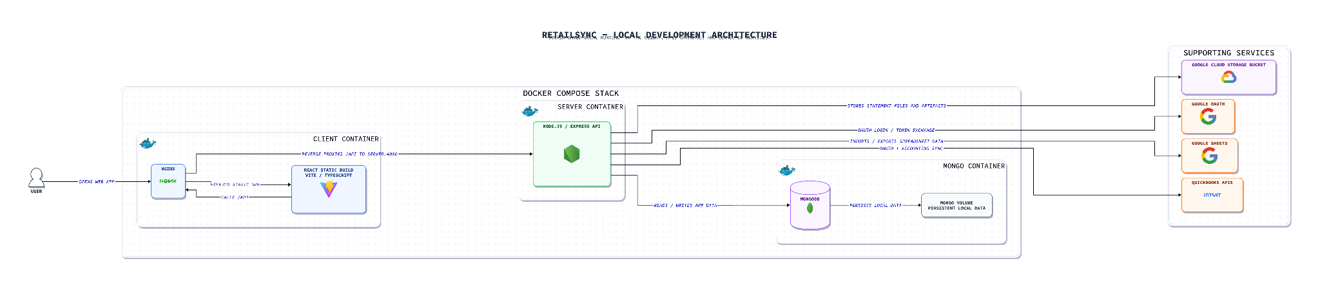
System Architecture
RetailSync

Slide 9
DEMO
RetailSync

Slide 10
Future Improvements
Lottery Scratchers Inventory and Sales Tracking
AI-Assisted File Management
Convenience Store Inventory Management
RetailSync

Slide 11
Thank you
Questions ?
RetailSync
School Name

